Slide 1
Zener Diode

Slide 2
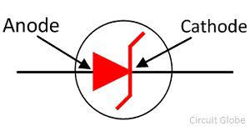
Introduction
The Zener diode's operation depends on the heavy doping of its p-n junction. The depletion region formed in the diode is very thin and the electric field is consequently very high.
Zener diode is designed to operate under reverse bias in the breakdown region and used as a voltage regulator
Symbol

Slide 3
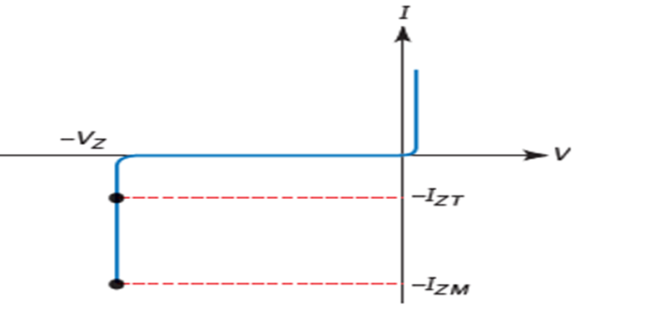
V I characteristics
Zener diodes can operate in any of three regions:
Forward, Leakage, Breakdown.
Fig.1 shows the VI graph of a zener diode
Forward region
It starts conducting around 0.7 V, just like an ordinary silicon diode.

Slide 4
V I characteristics
In the leakage region (between zero and breakdown), it has only a small reverse current.
In a zener diode, the breakdown has a very sharp knee, followed by an almost vertical increase in current. Note that the voltage is almost constant, approximately equal to Vz over most of the breakdown region.
Vz: The Zener voltage refers to the reverse breakdown voltage
I_{ZM} – max. amount of current the diode can handle without being
destroyed
I_{ZT} – the current level at which the V_{Z} rating of diode is measured

Slide 5
Zener resistance.
As long as the reverse current is less than I_{ZM}, the diode is operating within its safe range. If the current is greater than I_{ZM}, the diode will be destroyed. To prevent excessive reverse current, a current-limiting resistor must be used.
In the breakdown region, the reverse voltage across a diode equals the breakdown voltage plus the additional voltage across the bulk resistance. In the reverse region, the bulk resistance is referred to as the zener resistance.

Slide 6
Avalanche breakdown
The avalanche breakdown occurs when a high reverse voltage is applied across the diode.
As we increase the applied reverse voltage, the electric field across the junction increases. This electric field exerts a force on the electrons at the junction and frees them from covalent bonds.
These free electrons start moving with high velocity across the junction and collide with the other atoms, thus creating more free electrons. This results in a rapid increase in current.

Slide 7
Zener breakdown
Zener effect or Zener breakdown
When a diode is heavily doped, the depletion layer becomes very narrow. Because of this, the electric field across the depletion layer is very intense. The electric field intensity increases the kinetic energy of the free charge carriers. Thereby the carriers start jumping from one region to another. These energetic charge carriers collide with the atoms of the p-type and n-type material and produce the electron-hole .
Breakdown voltage is less than 4 V - zener effect occurs.
Breakdown voltage is greater than 6 V- avalanche effect
Breakdown voltage is between 4 to 6 V --both effects are present.

Slide 8
Temperature effect
When the ambient temperature changes, the zener voltage will change slightly. The temperature coefficient is negative for breakdown voltages less than 4 V (Zener effect).
The temperature coefficient is positive for breakdown voltages greater than 6 V (Avalanche effect).
Zener diodes with breakdown voltages between 4 and 6 V in which the temperature coefficient equals zero.

Slide 9

Zener Regulator
A zener diode is called as a voltage-regulator diode ,maintains a constant output voltage when the current changes.
In the Reverse-biased zener diode, to get breakdown operation, the source voltage V_{S} must be greater than the zener breakdown voltage V_{z} . A series resistor R _{s} is always used to limit the zener current to less than its maximum current rating. Otherwise, the zener diode will burn out.
Therefore, the current through the resistor is:

Slide 10
Problem
The zener diode has a breakdown voltage of 10 V. What are the minimum and maximum zener currents?
The minimum current occurs when the source voltage is minimum.
voltage across the resistor is 20 V - 10 V =10 V.
For the maximum current , voltage should be maximum, voltage across the resistor is 40V-10V=30V

Slide 11


Loaded Zener Regulator
The zener diode operates in the breakdown region and holds the load voltage constant. Even if the source voltage changes or the load resistance varies, the load voltage will remain fixed and equal to the zener voltage.
This is the voltage that exists when the zener diode is disconnected from
the circuit. This Thevenin voltage has to be greater than the zener voltage;
otherwise, breakdown cannot occur
Series Current
current through the series resistor is given by

Slide 12
Loaded Zener Regulator
Load Current
Ideally, the load voltage equals the zener voltage because the load resistor is in
parallel with the zener diode. Using Ohm’s law, calculate the load current
With Kirchhoff’s current law: Zener Current

Slide 13
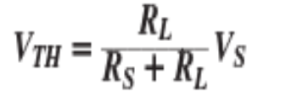
Problem
Is the zener diode operating in the breakdown region? Calculate the zener current ?
Since this Thevenin voltage is greater than the zener voltage, the zener diode is operating in the breakdown region

Slide 14
Problem (cont)
Note the voltage on both ends of the series resistor. Subtract the voltages, 18-10=8 V is across the series resistor. Then Ohm’s law gives:

Slide 15
Problem
For the given circuit ,find :(i) the output voltage (ii) the voltage drop across series resistance (iii) the current through zener diode.
Calculate the thevenin voltage

Slide 16
Problem (cont)
Since voltage across zener diode is greater than VZ (= 50 V), the zener is in the “on” state. It can be represented by a battery of 50 V

Slide 17
Zener parameters
Maximum Power
The power dissipation of a zener diode equals the product of its voltage and
current:
Maximum Current
Data sheets often include the maximum current I_{ZM} a zener diode can handle without exceeding its power rating. If this value is not listed, the maximum current can be found as follows:

Slide 18
Light Emitting Diode (LED)
A light-emitting diode (LED) is a diode that gives off visible light when forward biased.
Light-emitting diodes made by using elements like gallium, phosphorus and arsenic. By varying the quantities of these elements, it is possible to produce light of different wavelengths with colours that include red, green, yellow and blue.
For example, when a LED is manufactured using gallium arsenide, it will produce a red light. If the LED is made with gallium phosphide, it will produce a green light.

Slide 19
Light Emitting Diode (LED)
When light-emitting diode (LED) is forward biased ,the electrons from the n-type material cross the pn junction and recombine with holes in the p-type material. Free electrons in the conduction band are at a higher energy level than the holes in the valence band.
When recombination takes place, the recombining electrons release energy in the form of heat and light. In germanium and silicon diodes, almost the entire energy is given up in the form of heat and emitted light is insignificant.
However, in materials like gallium arsenide, the number of photons of light energy is sufficient to produce quite intense visible light.

Slide 20
LED Voltage and Current
The current through the LED does not exceed the safe value, a resistor R_{S} is connected in series with it . The input voltage is V_{S} and the voltage across LED is V_{D}.

Slide 21
Problem
What value of series resistor is required to limit the current through a LED to
20 mA with a forward voltage drop of 1.6 V when connected to a 10V supply ?
R_{S} =0.42 K ohm

Slide 22
Photo diode
A photo-diode is a reverse-biased silicon or germanium pn junction in which reverse current increases when the junction is exposed to light.
The reverse current in a photo-diode is directly proportional to the intensity of light falling on its pn junction. This means that greater the intensity of light falling on the pn junction of photo-diode, the greater will be the reverse current.
The inward arrow represent the incoming light.

Slide 23
Photo diode
When light (photons) falls on the pn junction, the energy is imparted by the photons to the atoms in the junction. This will create more free electrons.These additional free electrons will increase the reverse current.
As the intensity of light incident on the pn junction increases, the reverse current also increases. In other words, as the incident light intensity increases, the resistance of the device (photo-diode) decreases.

Slide 24
Thank you

